Slide 1

Toxicology
CHAPTER 22

Slide 2
National EMS Education Standard Competencies (1 of 3)
Medicine
Applies fundamental knowledge to provide basic emergency care and transportation based on assessment findings for an acutely ill patient.
Notes:
National EMS Education Standard Competencies
Medicine
Applies fundamental knowledge to provide basic emergency care and transportation based on assessment findings for an acutely ill patient.

Slide 3
National EMS Education Standard Competencies (2 of 3)
Toxicology
Recognition and management of
  Carbon monoxide poisoning
  Nerve agent poisoning
How and when to contact a poison control center
Notes:
National EMS Education Standard Competencies
Toxicology
• Recognition and management of
• Carbon monoxide poisoning
• Nerve agent poisoning
• How and when to contact a poison control center

Slide 4
National EMS Education Standard Competencies (3 of 3)
Anatomy, physiology, pathophysiology, assessment, and management of
  Inhaled poisons
  Ingested poisons
  Injected poisons
  Absorbed poisons
  Alcohol intoxication and withdrawal
Notes:
National EMS Education Standard Competencies
Anatomy, physiology, pathophysiology, assessment, and management of
• Inhaled poisons
• Ingested poisons
• Injected poisons
• Absorbed poisons
• Alcohol intoxication and withdrawal

Slide 5
Introduction (1 of 2)
Every day, we come into contact with potentially poisonous things.
Acute poisoning affects over 2 million people each year.
Chronic poisoning is more common.
Notes:
Lecture Outline
I. Introduction
A. Every day, we come into contact with things that are potentially poisonous.
B. Acute poisoning affects over 2 million people each year.
C. Chronic poisoning is more common.

Slide 6
Introduction (2 of 2)
Deaths caused by poisoning are fairly rare.
  Poisoning in children has decreased steadily since the 1960s due to child-resistant caps.
  Deaths caused by chronic poisoning in adults have been rising as a result of drug abuse.
Notes:
Lecture Outline
D. Deaths caused by poisoning are fairly rare.
1. Rates of death as the result of poisoning in children have decreased steadily since the 1960s due to child-resistant caps.
2. Deaths caused by chronic poisoning in adults have been rising as a result of drug abuse.

Slide 7
Identifying the Patient and the Poison (1 of 6)
Toxicology is the study of toxic or poisonous substances.
  Poison: any substance whose chemical action can damage body structures or impair body function
  Toxin: a poisonous substance produced by bacteria, animals, or plants
  Substance abuse: the misuse of any substance to produce a desired effect.
  Overdose: a toxic dose of a drug.
Notes:
Lecture Outline
II. Identifying the Patient and the Poison
A. Toxicology is the study of toxic or poisonous substances.
1. A poison is any substance whose chemical action can damage body structures or impair body function.
2. A toxin is a poisonous substance produced by bacteria, animals, or plants that acts by changing the normal metabolism of cells or destroying them.
a. Toxins can have acute or chronic effects.
3. Substance abuse is the misuse of any substance to produce a desired effect.
a. A common complication of substance abuse is overdose, when a patient takes a toxic dose of a substance.

Slide 8
Identifying the Patient and the Poison (2 of 6)
Your primary responsibility to the patient is to recognize that a poisoning has occurred.
  Pay attention to your surroundings.
  Very small amounts of some poisons can cause considerable damage or death.
The signs and symptoms of poisoning vary according to the specific agent.
Notes:
Lecture Outline
B. Your primary responsibility to the patient who has been poisoned is to recognize that a poisoning has occurred.
1. For your own safety, you must pay attention to your surroundings or you could also become exposed to the same substance.
2. Very small amounts of some poisons can cause considerable damage or death.
3. If you suspect that ingestion or exposure to a toxic substance has occurred, notify medical control and begin emergency treatment at once.
C. The signs and symptoms of poisoning vary according to the specific agent.

Slide 9
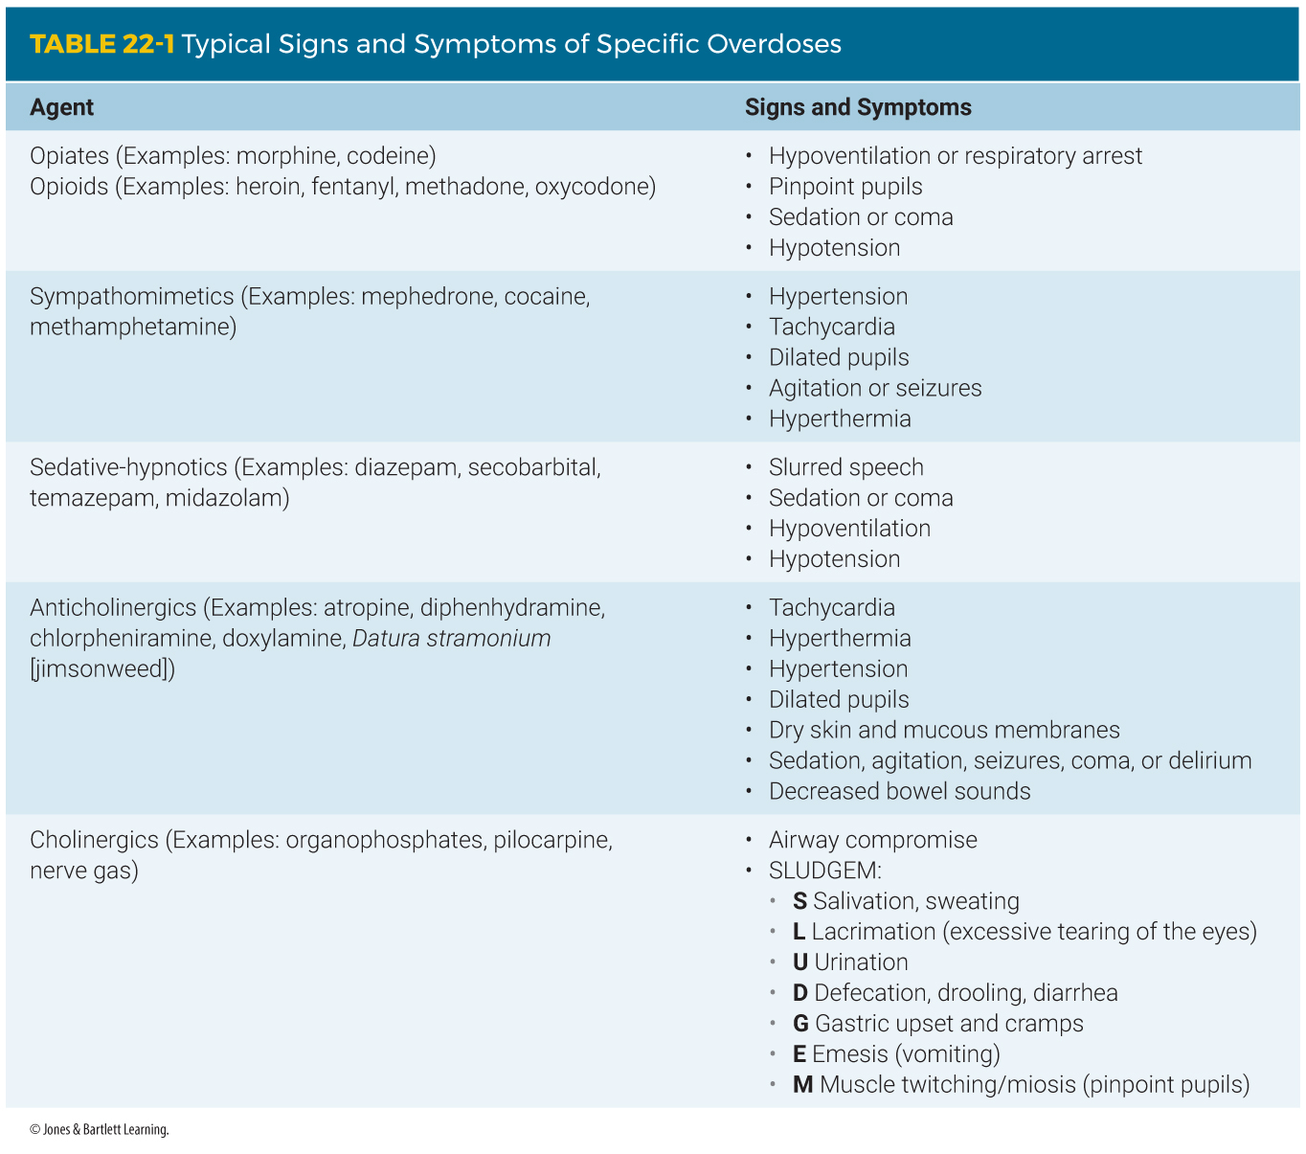
Identifying the Patient and the Poison (3 of 6)
Notes:
The table on this slide shows the signs and symptoms of specific types of overdoses.

Slide 10
Identifying the Patient and the Poison (4 of 6)
If possible, ask the patient:
  What substance did you take?
  When did you take it (or become exposed to it)?
  How much did you ingest?
  Did you have anything to eat or drink before or after you took it?
  Has anyone given you an antidote or any substance orally since you ingested it?
  How much do you weigh?
Notes:
Lecture Outline
1. If possible, while obtaining the SAMPLE history, ask the patient:
a. What substance did you take?
b. When did you take it (or become exposed to it)?
c. How much did you ingest?
d. Did you have anything to eat or drink before or after you took it?
e. Has anyone given you an antidote or any substance orally since you ingested it?
f. How much do you weigh?

Slide 11
Identifying the Patient and the Poison (5 of 6)
Try to determine the nature of the poison.
  Look around the immediate area for clues.
  Take any suspicious material with you.
  Containers at the scene can provide critical information.
Notes:
Lecture Outline
D. Try to determine the nature of the poison.
1. Look around the immediate area for an overturned bottle, a needle or syringe, scattered pills, chemicals, remains of food or drink items, or even an overturned or damaged plant.
2. Take any suspicious material with you to the ED.
3. Containers at the scene can provide critical information, such as:
a. Name and concentration of the drug
b. Ingredients
c. Number of pills originally in the bottle
d. Name of the manufacturer
e. Prescribed dose

Slide 12
Identifying the Patient and the Poison (6 of 6)
If the patient vomits, examine the contents for pill fragments.
Note and document anything unusual that you see.
Notes:
Lecture Outline
4. If the patient vomits, examine the contents for pill fragments.
5. Note and document anything unusual that you see.

Slide 13
How Poisons Enter the Body (1 of 2)
How you provide treatment depends on how the poison got into the patient’s body.
Four routes to consider:
  Inhalation
  Absorption
  Ingestion
  Injection
All four routes can lead to life-threatening conditions.
Notes:
Lecture Outline
A. How you provide treatment depends on how the poison got into the patient’s body in the first place.
1. The four routes to consider are:
a. Inhalation
b. Absorption (surface contact)
c. Ingestion
d. Injection
2. All four routes of poisoning can lead to life-threatening conditions.

Slide 14
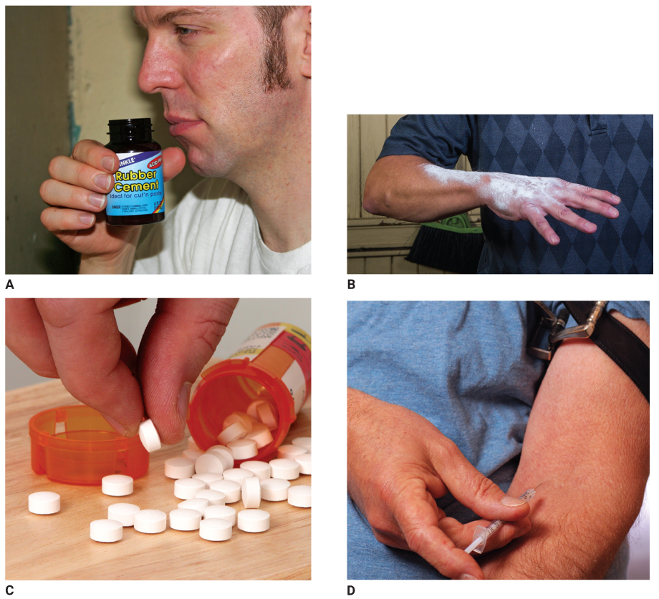
How Poisons Enter the Body (2 of 2)
FIGURE 22-2 There are four routes by which a poison can enter the body. A. Inhalation. B. Absorption (surface contact). C. Ingestion. D. Injection.
A: © Jones & Bartlett Learning. Photographed by Kimberly Potvin; B: © Jones & Bartlett Learning;
C: © Jaimie Duplass/Shutterstock; D: © Cate Frost/Shutterstock.
Notes:
The figure on this slide shows the four routes poison can enter the body: inhalation, absorption, ingestion, and injection.

Slide 15
Inhaled Poisons (1 of 3)
Move the patient into fresh air immediately.
The patient may require supplemental oxygen.
If you suspect the presence of a toxic gas, call for specialized resources such as the hazmat team.
Notes:
Lecture Outline
B. Inhaled poisons
1. Move the patient into fresh air immediately.
2. The patient may require supplemental oxygen.
3. If you suspect the presence of a toxic gas, call for specialized resources such as the hazmat team.

Slide 16
Inhaled Poisons (2 of 3)
Some patients may need decontamination by the hazmat team after removal from the toxic environment.
All patients who have inhaled poison require immediate transport.
  Be prepared to use supplemental oxygen.
  Make sure a suctioning unit is available.
Notes:
Lecture Outline
4. Some patients may need decontamination by the hazmat team after removal from the toxic environment.
5. All patients who have inhaled poison require immediate transport to an emergency department.
a. Be prepared to use supplemental oxygen via a nonrebreathing mask and/or ventilatory support with a bag-mask device, if necessary.
b. Make sure a suctioning unit is available in case the patient vomits.

Slide 17
Inhaled Poisons (3 of 3)
Some patients use inhaled poisons to commit suicide in a vehicle.
  Exhaust fumes contain high levels of carbon monoxide.
Notes:
Lecture Outline
6. Some patients use inhaled poisons to commit suicide in a vehicle.
a. Leaving a car engine running in an enclosed garage can cause the exhaust fumes, which contain high levels of carbon monoxide, to cause the patient to lose consciousness and eventually stop breathing.

Slide 18
Absorbed and Surface Contact Poisons (1 of 6)
Can affect the patient in many ways:
  Skin, mucous membrane, or eye damage
  Chemical burns
  Rashes or lesions
  Systemic effects
It is important to distinguish between contact burns and contact absorption.
Notes:
Lecture Outline
C. Absorbed and surface contact poisons
1. Can affect the patient in many ways.
a. Skin, mucous membrane, or eye damage
b. Chemical burns
c. Rashes or lesions
d. Systemic effects
2. It is important to distinguish between contact burns and contact absorption.

Slide 19
Absorbed and Surface Contact Poisons (2 of 6)
Signs and symptoms include:
  A history of exposure
  Liquid or powder on a patient’s skin
  Burns
  Itching
  Irritation
  Redness of skin
  Typical odors of the substance
Notes:
Lecture Outline
3. Signs and symptoms of absorbed poisoning include:
a. A history of exposure
b. Liquid or powder on a patient’s skin
c. Burns
d. Itching
e. Irritation
f. Redness of the skin
g. Typical odors of the substance

Slide 20
Absorbed and Surface Contact Poisons (3 of 6)
Emergency treatment:
  Avoid contaminating yourself or others.
  Remove the substance from patient as rapidly as possible.
Remove all contaminated clothing.
Flush and wash the skin.
Notes:
Lecture Outline
4. Emergency treatment for a typical contact poisoning includes:
a. Avoid contaminating yourself or others.
b. While protecting yourself, remove the substance from the patient as rapidly as possible.
c. Remove all contaminated clothing.
5. Flush and wash the skin.

Slide 21
Absorbed and Surface Contact Poisons (4 of 6)
If dry powder has been spilled, brush off the powder, flood the area with water for 15 to 20 minutes, then wash skin with soap and water.
If liquid has been spilled onto the skin, flood for 15 to 20 minutes.
Notes:
Lecture Outline
a. If dry powder has been spilled, brush off the powder, then flood the area with water for 15 to 20 minutes, then wash skin with soap and water.
b. If liquid has been spilled onto the skin, flood for 15 to 20 minutes.

Slide 22
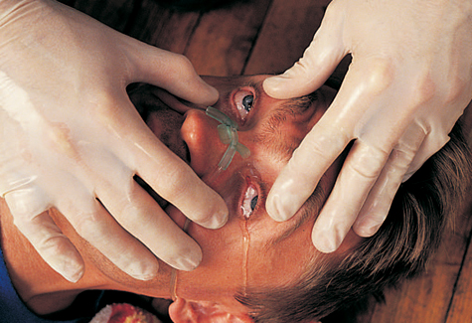
Absorbed and Surface Contact Poisons (5 of 6)
If a chemical agent is introduced to the eyes, irrigate them quickly and thoroughly.
FIGURE 22-4 If chemical agents are in the patient’s eyes, irrigate the eyes quickly and thoroughly, ensuring that the irrigation fluid runs from the bridge of the nose outward. (Use of a nasal cannula is shown.).
© American Academy of Orthopaedic Surgeons.
Notes:
Lecture Outline
c. If a chemical agent is introduced to the eyes, irrigate them quickly and thoroughly.

Slide 23
Absorbed and Surface Contact Poisons (6 of 6)
Many chemical burns occur in an industrial setting.
  Safety showers and specific protocols for handling surface burns may be available.
  Hazmat team should be available to assist you.
  After decontamination, promptly transport to the ED for definitive care.
  Obtain material safety data sheets.
Notes:
Lecture Outline
7. Many chemical burns occur in an industrial setting.
a. Safety showers and specific protocols for handling surface burns may be available.
b. A hazmat team should be available to assist you.
c. Ensure you, your team members, and the exposed patient are thoroughly decontaminated.
d. After decontamination, promptly transport to the ED for definitive care.
e. Obtain material safety data sheets.

Slide 24
Ingested Poisons (1 of 4)
About 80% of poisoning is by mouth.
  Liquids
  Household cleaners
  Contaminated food
  Plants
  Drugs
Notes:
Lecture Outline
D. Ingested poisons
1. About 80% of poisoning is by mouth.
a. Liquids
b. Household cleaners
c. Contaminated food
d. Plants
e. Drugs

Slide 25
Ingested Poisons (2 of 4)
Usually accidental in children and deliberate in adults
Signs and symptoms include burns around the mouth, gastrointestinal pain, vomiting, cardiac dysrhythmias, and seizures.
Notes:
Lecture Outline
2. Ingested poisoning is usually accidental in children and deliberate in adults.
3. Signs and symptoms vary greatly with the:
a. Type of poison
b. Age of the patient
c. Time that has passed since the ingestion
4. Signs and symptoms include burns around the mouth, gastrointestinal pain, vomiting, cardiac dysrhythmias, and seizures.

Slide 26
Ingested Poisons (3 of 4)
Treat signs and symptoms and notify the poison center and medical control of the patient’s condition.
Consider whether there is unabsorbed poison remaining in the gastrointestinal tract and whether you can safely and effectively prevent its absorption.
Notes:
Lecture Outline
5. Treat signs and symptoms and notify the poison center and medical control of the patient’s condition.
a. If patient has altered mental status, protect the patient from aspirating on vomit.
6. Consider whether there is unabsorbed poison remaining in the gastrointestinal tract and whether you can safely and effectively prevent its absorption.

Slide 27
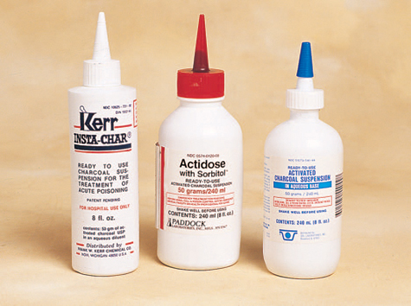
Ingested Poisons (4 of 4)
Some EMS systems allow EMTs to administer activated charcoal.
Always immediately assess the ABCs of every patient who has been poisoned.
FIGURE 22-7 Activated charcoal comes as a premixed suspension.
© American Academy of Orthopaedic Surgeons.
Notes:
Lecture Outline
7. Some EMS systems allow EMTs to administer activated charcoal.
8. You should always immediately assess the ABCs of every patient who has been poisoned.

Slide 28
Injected Poisons (1 of 2)
Exposure includes intravenous drug abuse and envenomation by insects, arachnids, and reptiles.
Usually absorbed quickly into the body or cause intense local tissue destruction
Cannot be diluted or removed from the body in the field
Notes:
Lecture Outline
E. Injected poisons
1. Exposure by injection includes intravenous drug abuse and envenomation by insects, arachnids, and reptiles.
a. Injected poisons are usually absorbed quickly into the body or cause intense local tissue destruction.
b. They cannot be diluted or removed from the body in the field.

Slide 29
Injected Poisons (2 of 2)
Signs and symptoms may include weakness, dizziness, fever/chills, unresponsiveness, and excitability.
Monitor the airway, provide high-flow oxygen, and be alert for nausea and vomiting.
Remove rings, watches, and bracelets from areas around the injection site if swelling occurs.
Notes:
Lecture Outline
2. Signs and symptoms include:
a. Weakness
b. Dizziness
c. Fever
d. Chills
e. Unresponsiveness
f. Excitability
3. Monitor the airway, provide high-flow oxygen, and be alert for nausea and vomiting.
4. Remove rings, watches, and bracelets from areas around the injection site if swelling occurs.

Slide 30
Scene Size-up
Take standard precautions and look for clues:
  Is there an odor in the room? Is the scene safe?
  Are there medication bottles lying around? Is there medication missing that might indicate an overdose?
  Are alcoholic beverage containers present?
  Are there syringes or other drug paraphernalia?
  Is there a suspicious odor that may indicate the presence of a drug laboratory?
Notes:
Lecture Outline
IV. Patient Assessment
A. Scene size-up
1. Take standard precautions and look for clues that might indicate the substance involved.
a. Is there an odor in the room? If so, is the scene safe?
b. Are there medication bottles lying around the patient and the scene? If so, is there medication missing that might indicate an overdose?
c. Are there alcoholic beverage containers present?
d. Are there syringes or other drug paraphernalia on the scene?
e. Is there a suspicious odor and/or drug paraphernalia present that may indicate the presence of a drug laboratory?
2. Keep a constant eye on the surroundings and keep an open mind when questioning the patient or bystanders to avoid mistaken conclusions.

Slide 31
Primary Assessment (1 of 3)
Determine the severity of the patient’s condition.
  Obtain a general impression.
  Assess the level of consciousness.
  Determine any life threats.
  Do not assume a conscious, alert, and oriented patient is in stable condition.
Notes:
Lecture Outline
B. Primary assessment
1. Determine the severity of the patient’s condition.
a. Obtain a general impression of the patient.
b. Assess his or her level of consciousness.
c. Determine any life threats.
d. Do not assume a conscious, alert, and oriented patient is in stable condition.

Slide 32
Primary Assessment (2 of 3)
Airway and breathing
  Ensure that the patient has an open airway and adequate ventilation.
  If patient has difficulty breathing or an inhalation injury, begin oxygen therapy.
  Have suction available; these patients are susceptible to vomiting.
Circulation
  Assess the pulse and skin condition.
  Will vary depending on the substance involved
Notes:
Lecture Outline
2. Airway and breathing
a. Quickly ensure that the patient has an open airway and adequate ventilation.
b. If the patient has any dif­ficulty breathing, begin oxygen therapy.
c. Consider inserting an airway adjunct in unresponsive patients.
d. Have suction available; these patients are susceptible to vomiting.
3. Circulation
a. Assess the pulse and skin condition.
b. You will find variations depending on the substance involved.

Slide 33
Primary Assessment (3 of 3)
Transport decision
  Consider prompt transport for patients with obvious alterations in the XABCs or for patients you have determined have a poor general impression.
  Everyone who is exposed to the hazardous material must be thoroughly decontaminated by the hazmat team before leaving the scene.
Notes:
Lecture Outline
4. Transport decision
a. Consider prompt transport for patients with obvious alterations in the XABCs or for patients you have determined have a poor general impression.
b. Everyone who is exposed to the hazardous material must be thoroughly decontaminated by the hazmat team before leaving the scene.

Slide 34
History Taking (1 of 3)
Investigate the chief complaint.
  If your patient is responsive, begin with an evaluation of the exposure and the SAMPLE history.
  If your patient is unresponsive, obtain the history from other sources.
Notes:
Lecture Outline
C. History taking
1. Investigate the chief complaint.
a. If your patient is responsive, begin with an evaluation of the exposure and the SAMPLE history.
b. If the patient is unresponsive, attempt to obtain the history from other sources:

Slide 35
History Taking (2 of 3)
In addition to SAMPLE, ask the following questions:
  What is the substance involved?
  When did the patient become exposed to it?
  How much did the patient ingest or what was the level of exposure?
Notes:
Lecture Outline
2. SAMPLE history
a. In addition to the SAMPLE history, ask the following questions:
i. What is the substance involved?
ii. When did the patient ingest or become exposed to the substance?
iii. How much did the patient ingest or what was the level of exposure?

Slide 36
History Taking (3 of 3)
Questions (cont’d):
  Over what period did the patient take or was exposed to the substance?
  Has the patient or a bystander performed any intervention?
  How much does the patient weigh?
Notes:
Lecture Outline
iv. Over what period did the patient take or was exposed to the substance?
v. Has the patient or a bystander performed any intervention? Has the intervention helped?
vi. How much does the patient weigh?

Slide 37
Secondary Assessment
Physical examinations
  Focus on the area of the body involved with the poisoning or the route of exposure.
  A general review of all body systems may help to identify systemic problems.
A complete set of baseline vital signs is important.
Notes:
Lecture Outline
D. Secondary assessment
1. You may not have time to conduct a secondary assessment.
2. Physical examinations
a. Focus on the area of the body involved with the poisoning or the route of exposure.
b. A general review of all body systems may help to identify systemic problems.
3. A complete set of baseline vital signs is important.
a. Alterations in the level of consciousness, pulse, respirations, blood pressure, and skin are the more sensitive indicators that something serious is wrong.

Slide 38
Reassessment (1 of 3)
Reassess the adequacy of the XABCs.
Repeat vital signs; compare them with the baseline set.
Evaluate your interventions.
  Every 15 minutes for a stable patient
  Every 5 minutes, or constantly, for a patient who has consumed a harmful or lethal dose
Notes:
Lecture Outline
Reassessment
1. Continually reassess the adequacy of the patient’s ABCs.
2. Repeat vital signs; compare them with the baseline set.
3. Evaluate the effectiveness of interventions you have provided.
a. Every 15 minutes for a stable patient
b. Every 5 minutes, or constantly, for a patient who has consumed a harmful or lethal dose

Slide 39
Reassessment (2 of 3)
Treatment
  Supporting the XABCs is your most important task.
  Contact medical control or a poison center to discuss treatment options.
  Manage airborne exposures with oxygen.
  Remove contact exposures with water.
  Consider activated charcoal for ingestions.
Notes:
Lecture Outline
4. Treatment
a. Supporting the ABCs is your most important task.
b. Contact medical control or a poison center to discuss treatment options.
c. Manage airborne exposures with oxygen.
d. Remove contact exposures with copious amounts of water unless contraindicated.
e. Consider activated charcoal for ingested poisons.

Slide 40
Reassessment (3 of 3)
Communication and documentation
  Report as much information as you have about the poison or chemical to the hospital.
  Bring the material data sheet to the hospital if the poisoning occurred in a work setting.
Notes:
Lecture Outline
5. Communication and documentation
a. Report as much information as you have about the poison or chemical to the hospital.
b. If the poisoning or exposure occurred in a work setting, bring the material data sheet to the hospital.

Slide 41
Emergency Medical Care (1 of 6)
Ensure scene safety.
Remove tablets or fragments from the patient’s mouth.
Wash or brush the poison from the patient’s skin.
Notes:
Lecture Outline
V. Emergency Medical Care
A. Ensure scene safety.
1. Follow standard precautions.
2. Perform external decontamination.
B. Remove tablets or fragments from the patient’s mouth and wash or brush the poison from the patient’s skin.
C. Treatment focuses on support.

Slide 42
Emergency Medical Care (2 of 6)
Assess and maintain the patient’s XABCs.
Provide oxygen and perform assisted ventilations if necessary.
Treat for shock and transport the patient promptly to the nearest hospital.
Some EMS systems allow EMTs to give activated charcoal by mouth.
Notes:
Lecture Outline
1. Assess and maintain the patient’s XABCs.
2. Provide oxygen and perform assisted ventilations if necessary.
3. Treat for shock, if necessary, and transport the patient promptly to the nearest appropriate hospital.
D. Some EMS systems allow EMTs to give activated charcoal by mouth.

Slide 43
Emergency Medical Care (3 of 6)
Activated charcoal binds to specific toxins, which are then carried out of the body in the stool.
Contraindicated in patients who have:
  Ingested alkali poisons, cyanide, ethanol, iron, lithium, methanol, mineral acids, or organic solvents
  A decreased LOC and cannot protect their airway
Notes:
Lecture Outline
1. Activated charcoal binds to specific toxins and prevents their absorption by the body; the toxins are then carried out of the body in the stool.
2. Activated charcoal is not indicated for patients:
a. Who have ingested alkali poisons, cyanide, ethanol, iron, lithium, methanol, mineral acids, or organic solvents
b. Who have a decreased level of consciousness and cannot protect their airway

Slide 44
Emergency Medical Care (4 of 6)
If local protocol permits, you may carry a premixed suspension of 50 g of activated charcoal.
  The usual dose for an adult or child is 1 g per kilogram of body weight.
Notes:
Lecture Outline
3. If local protocol permits, you will likely carry plastic bottles of premixed suspension, each containing up to 50 g of activated charcoal.
a. The usual dose for an adult or child is 1 g of activated charcoal per kilogram of body weight.

Slide 45
Emergency Medical Care (5 of 6)
Before you give a patient charcoal, obtain approval from medical control.
  Shake the bottle vigorously.
  You may need to convince the patient to drink it, but never force it.
  Record the time when you administered activated charcoal.
  If the patient refuses activated charcoal, document the refusal and transport the patient for further evaluation.
Notes:
Lecture Outline
4. Before you give a patient charcoal, obtain approval from medical control.
a. Shake the bottle vigorously to mix the suspension.
b. You may need to convince the patient to drink it, but never force it.
c. Record the time when you administered activated charcoal.
d. If the patient refuses activated charcoal, document the refusal and your attempts to counsel the patient, and transport the patient for further evaluation.

Slide 46
Emergency Medical Care (6 of 6)
Side effects are constipation and black stools.
If the patient has ingested a poison that causes nausea, he or she may vomit after taking charcoal.
Notes:
Lecture Outline
5. Side effects of ingesting activated charcoal are constipation and black stools.
6. If the patient has ingested a poison that causes nausea, he or she may vomit after taking activated charcoal and the dose will have to be repeated.

Slide 47
Specific Poisons (1 of 2)
Over time, a person who routinely misuses a substance may need increasing amounts of it to achieve the same result.
  This is called developing a tolerance.
  A person with an addiction has an overwhelming need to continue using the substance, at whatever cost.
  Almost any substance can be abused.
Notes:
Lecture Outline
VI. Specific Poisons
A. Over time, a person who routinely misuses a substance may need increasing amounts of it to achieve the same result.
1. This is called developing a tolerance to the substance.
2. A person with an addiction has an overwhelming desire or need to continue using the substance, at whatever cost, with a tendency to increase the dose.
3. Almost any substance can be abused.

Slide 48
Specific Poisons (2 of 2)
The importance of safety awareness and standard precautions cannot be overemphasized.
  Known drug abusers have a fairly high incidence of serious and undiagnosed infections, including HIV and hepatitis.
Notes:
Lecture Outline
B. The importance of safety awareness and standard precautions in caring for victims of drug abuse cannot be overemphasized.
1. Known drug abusers have a fairly high incidence of serious and undiagnosed infections, including HIV and hepatitis.
a. Expect the unexpected and remember: the drug user, not the drug, can pose the greatest threat.

Slide 49
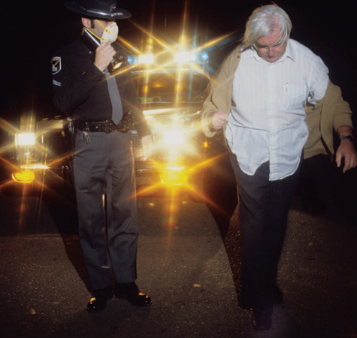
Alcohol (1 of 5)
Many calls for service have a connection to alcohol use.
FIGURE 22-8 Alcohol intoxication causes altered mental status, slowed reflexes, and impaired reaction time.
© David R. Frazier/Photo Researchers, Inc.
Notes:
Lecture Outline
C. Alcohol
1. Many calls for service have a connection to alcohol use.

Slide 50
Alcohol (2 of 5)
Alcohol can damage the liver, whether thorough chronic overuse or occasional heavy use (binge drinking).
Binge use can be more damaging than chronic use, depending on the frequency of the binging and the surrounding circumstances.
Notes:
Lecture Outline
a. Alcohol can damage the liver, whether thorough chronic overuse or occasional heavy use (binge drinking).
b. Binge use can be more damaging than chronic use, depending on the frequency of the binging and the surrounding circumstances.

Slide 51
Alcohol (3 of 5)
Alcohol is a powerful CNS depressant.
  Decreases activity and excitement
  Induces sleep
  Dulls the sense of awareness, slows reflexes, and reduces reaction time
  May cause aggressive and inappropriate behavior and lack of coordination
  Alcohol increases the effects of other drugs and is commonly taken with other substances.
Notes:
Lecture Outline
2. Alcohol is a powerful CNS depressant.
a. It is a sedative and a hypnotic.
b. In general, alcohol dulls the sense of awareness, slows reflexes, and reduces reaction time.
c. It may also cause aggressive and inappropriate behavior and lack of coordination.
d. A person who appears intoxicated may have other medical problems as well.
i. Look for signs of head trauma, mental illness, toxic reactions, or uncontrolled diabetes.
ii. Severe acute alcohol ingestion may cause hypoglycemia.
3. Alcohol increases the effects of many other drugs and is commonly taken with other substances.

Slide 52
Alcohol (4 of 5)
If a patient exhibits signs of serious CNS depression, provide respiratory support.
  May cause vomiting
Patients may experience frightening hallucinations, or delirium tremens (DTs).
Notes:
Lecture Outline
4. If a patient exhibits signs of serious CNS depression, provide respiratory support.
a. Depression of the respiratory system can also cause emesis, or vomiting.
5. Patients in alcohol withdrawal may experience frightening hallucinations, or delirium tremens (DTs).

Slide 53
Alcohol (5 of 5)
DTs are characterized by:
  Agitation and restlessness
  Fever
  Sweating
  Tremors
  Confusion/disorientation
  Delusions/hallucinations
  Seizures
Notes:
Lecture Outline
a. Characterized by:
i. Agitation and restlessness
ii. Fever
iii. Sweating
iv. Tremors
v. Confusion and/or disorientation
vi. Delusions and/or hallucinations
vii. Seizures
b. These conditions may develop after a person stops drinking or when alcohol consumption levels are decreased suddenly.
c. Provide prompt transport.
d. Reassure the patient and provide necessary care and emotional support.

Slide 54
Opioids (1 of 7)
An opioid is a type of narcotic medication used to relieve pain.
An opiate is a subset of the opioid family, and refers to natural, nonsynthetic opioids.
Named for the opium in poppy seeds, from which codeine and morphine are derived
Notes:
Lecture Outline
D. Opioids
1. A narcotic is a drug that produces sleep or altered mental consciousness.
2. An opioid is a type of narcotic medication used to relieve pain.
a. An opiate is a subset of the opioid family, and refers to natural, nonsynthetic opioids.
b. Prescription opioid drugs are among the most commonly abused drugs in the United States.
c. Some people become physically dependent on opioids after taking an appropriate medical prescription.

Slide 55
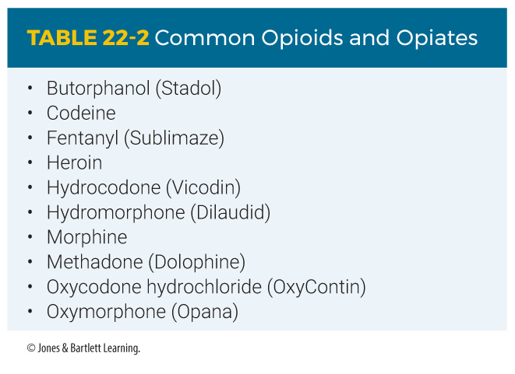
Opioids (2 of 7)
Notes:
Lecture Outline

Slide 56
Opioids (3 of 7)
Prescription opioid drugs are among the most commonly abused drugs in the United States.
Some people become physically dependent on opioids after taking an appropriate medical prescription.
Notes:
Lecture Outline
b. Prescription opioid drugs are among the most commonly abused drugs in the United States.
c. Some people become physically dependent on opioids after taking an appropriate medical prescription.

Slide 57
Opioids (4 of 7)
These agents are CNS depressants and can cause severe respiratory depression and then cardiac arrest if not treated promptly.
  Tolerance develops quickly.
  Some users may require massive doses to experience the same high.
  Often cause nausea and vomiting
  May lead to hypotension
Notes:
Lecture Outline
4. These agents are CNS depressants and can cause severe respiratory depression and then cardiac arrest if not treated promptly.
a. Tolerance develops quickly, so some users may require massive doses to experience the same high.
b. These drugs often cause nausea and vomiting and may lead to the development of hypotension.

Slide 58
Opioids (5 of 7)
Although seizures are uncommon, they can occur.
Patients typically appear sedated or unconscious and cyanotic with pinpoint pupils.
Notes:
Lecture Outline
c. Although seizures are uncommon, they can occur.
d. Patients typically appear sedated or unconscious and cyanotic with pinpoint pupils.

Slide 59
Opioids (6 of 7)
Naloxone reverses the effects of opiate or opioid overdose.
  Can be given intravenously, intramuscularly, or intranasally
  In many EMS systems, EMTs administer naloxone by the intranasal route.
  Should only be used when the patient has agonal respirations or is apneic
Notes:
Lecture Outline
5. Naloxone (Narcan) reverses the effects of opiate or opioid overdose.
a. Can be given by the intravenously, intramuscularly, or intranasally
b. In many EMS systems, EMTs administer naloxone by the intranasal route.
i. Should only be used when the patient has agonal respirations or is apneic

Slide 60
Opioids (7 of 7)
Naloxone (cont’d)
  In some areas, lay people are permitted to administer naloxone.
  Find out from bystanders if the patient was given naloxone.
Notes:
Lecture Outline
c. In some areas, lay people are permitted to administer naloxone; find out from bystanders if the patient was given naloxone.

Slide 61
Sedative-Hypnotic Drugs (1 of 2)
Barbiturates and benzodiazepines are CNS depressants.
  Alter the level of consciousness.
  Patient may appear drowsy, peaceful, or intoxicated.
Notes:
Lecture Outline
E. Sedative-hypnotic drugs
1. Barbiturates and benzodiazepines are easy to obtain and relatively cheap.
a. These drugs are CNS depressants and alter the level of consciousness, with effects similar to those of alcohol.
b. The patient may appear drowsy, peaceful, or intoxicated.

Slide 62
Sedative-Hypnotic Drugs (2 of 2)
These agents are generally taken by mouth.
  Occasionally, they are dissolved in water and injected.
  IV sedative-hypnotic drugs quickly induce tolerance.
  These drugs may be given to people as a “knock-out” drink.
  Treatment is to ensure airway is patent, assist ventilation, and provide prompt transport.
Notes:
Lecture Outline
2. In general, these agents are taken by mouth.
a. Occasionally, the capsules are suspended or dissolved in water and injected.
b. IV sedative-hypnotic drugs quickly induce tolerance, so the person requires increasingly larger doses.
3. These drugs may be given to people as a “knock-out” drink, or “Mickey Finn,” to incapacitate them without their knowledge.
4. Generally, your treatment is to ensure airway is patent, assist ventilations, and provide prompt transport.

Slide 63
Abused Inhalants (1 of 2)
These agents are inhaled.
  Acetone, toluene, xylene, hexane
  Found in glues, cleaning compounds, paint thinners, and lacquers
  Gasoline and halogenated hydrocarbons are also abused.
  Commonly abused by teenagers
Notes:
Lecture Outline
F. Abused inhalants
1. These agents are inhaled instead of ingested or injected.
a. Some of the more common agents include acetone, toluene, xylene, and hexane.
b. Found in glues, cleaning compounds, paint thinners, and lacquers
2. Gasoline and various halogenated hydrocarbons such as Freon, used as propellants in aerosol sprays, are also abused as inhalants.
a. These are commonly abused by teenagers.

Slide 64
Abused Inhalants (2 of 2)
Always use special care.
  Halogenated hydrocarbon solvents can make the heart hypersensitive to the patient’s own adrenaline.
  Keep patients from struggling or exerting themselves.
  Use a stretcher to move the patient, give oxygen, and transport to the hospital.
Notes:
Lecture Outline
3. Effects of inhalants range from mild drowsiness to coma, and often cause seizures.
4. Halogenated hydrocarbon solvents can make the heart hypersensitive to the patient’s own adrenaline.
a. Try to keep such patients from struggling with you or exerting themselves.
b. Use a stretcher to move the patient, give oxygen, and transport the patient to the hospital.

Slide 65
Hydrogen Sulfide (1 of 2)
Hydrogen sulfide
  A highly toxic, colorless, and flammable gas with a distinctive rotten-egg odor
  Affects all organs, but it has the most impact on the lungs and CNS.
  Used to commit suicide
  If you suspect the presence of a toxic gas, wait for a hazmat team to tell you the scene is safe.
Notes:
Lecture Outline
G. Hydrogen sulfide
1. A highly toxic, colorless, and flammable gas with a distinctive rotten-egg odor.
2. Affects all organs, but it has the most impact on the lungs and CNS.
3. Used to commit suicide; referred to as chemical or detergent suicide
a. If you approach an enclosed vehicle with an unconscious patient inside, be alert for warning signs, as well as containers, buckets, or pots.
b. If you suspect the presence of a toxic gas, wait for a hazmat team to tell you the scene is safe.

Slide 66
Hydrogen Sulfide (2 of 2)
Signs and symptoms:
  Nausea and vomiting, confusion, dyspnea, a loss of consciousness, seizures, shock, coma, and cardiopulmonary arrest
Once the patient has been decontaminated, management is largely supportive.
  Monitor and assist the patient’s respiratory and cardiovascular functions.
  Provide rapid transport.
Notes:
Lecture Outline
5. Signs and symptoms include nausea and vomiting, confusion, dyspnea, a loss of consciousness, seizures, shock, coma, and cardiopulmonary arrest.
6. Once the patient has been decontaminated, management is largely supportive.
a. Monitor and assist the patient’s respiratory and cardiovascular functions.
b. Provide rapid transport.

Slide 67
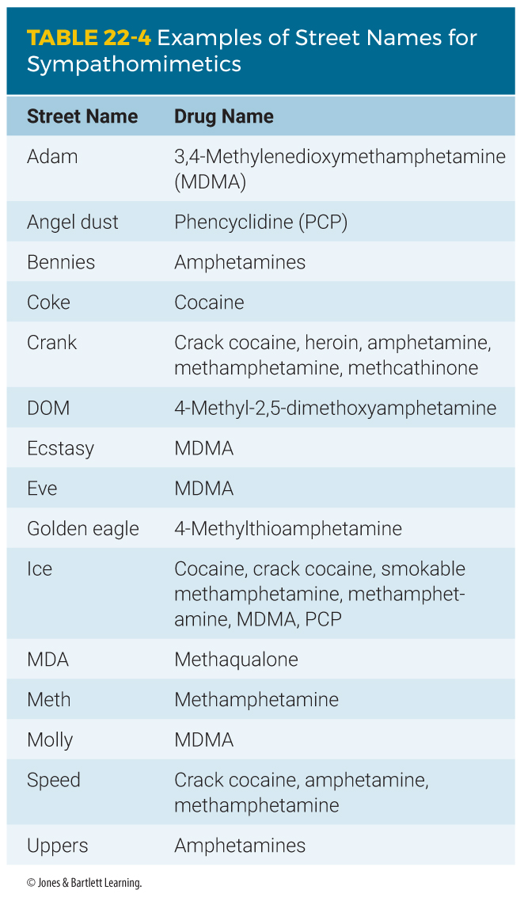
Sympathomimetics (1 of 4)
CNS stimulants that mimic the effects of the sympathetic nervous system
Notes:
Lecture Outline
H. Sympathomimetics
1. CNS stimulants that mimic the effects of the sympathetic nervous system.

Slide 68
Sympathomimetics (2 of 4)
Produce an excited state.
  Frequently cause hypertension, tachycardia, and dilated pupils
  Includes amphetamines, methamphetamines, phentermine hydrochloride, and Benzedrine
  Designer drugs, such as MDMA, are also frequently abused.
  Commonly taken by mouth; also injected by drug abusers
Notes:
Lecture Outline
a. Frequently cause hypertension, tachycardia, and dilated pupils.
b. A stimulant is an agent that produces an excited state.
2. Examples include amphetamines, methamphetamines, phentermine hydrochloride, and amphetamine sulfate (Benzedrine), and designer drugs, such as MDMA (ecstasy or Molly).

Slide 69
Sympathomimetics (3 of 4)
Cocaine may be taken in a number of different ways.
  Can be absorbed through all mucous membranes and even across the skin
  Immediate effects include excitement and euphoria and last less than an hour.
  Smoked crack is the most potent.
Notes:
Lecture Outline
3. Cocaine may be taken in a number of different ways.
a. It can be absorbed through all mucous membranes and even across the skin.
b. Immediate effects include excitement and euphoria and last less than an hour.
c. Smoked crack produces the most rapid means of absorption and, therefore, the most potent effect.

Slide 70
Sympathomimetics (4 of 4)
Acute overdose is a genuine emergency.
  Patients have a high risk of seizures, cardiac dysrhythmias, and stroke.
  Patients may experience hallucinations or paranoia.
  Do not leave the patient unattended.
  Provide prompt transport.
Notes:
Lecture Outline
4. Acute overdose is a genuine emergency.
a. Patients have a high risk of seizures, cardiac dysrhythmias, and stroke.
b. Patients may be experiencing hallucinations or paranoia, placing you at risk.
c. Law enforcement officers should restrain the patient if necessary.
d. Do not leave the patient unattended during transport.
5. Patients need prompt transport to the ED. Give supplemental oxygen and be ready to provide suctioning.

Slide 71
Synthetic Cathinones (Bath Salts) (1 of 2)
An emerging class of drugs similar to MDMA.
Produce euphoria, increased mental clarity, and sexual arousal.
  Most users of this drug snort or insufflate the powder nasally.
  Effects reportedly last as long as 48 hours.
Notes:
Lecture Outline
I. Synthetic cathinones (bath salts)
1. An emerging class of drugs similar to MDMA.
2. Sold as bath salts to escape the legal restrictions imposed on illicit drugs.
3. Produce euphoria, increased mental clarity, and sexual arousal.
a. Most users of this drug snort or insufflate the powder nasally.
b. Effects reportedly last as long as 48 hours.

Slide 72
Synthetic Cathinones (Bath Salts) (2 of 2)
Adverse effects include:
  Teeth grinding, appetite loss, muscle twitching, lip-smacking, confusion, gastrointestinal conditions, paranoia, headache, elevated heart rate, and hallucinations
Keep the patient calm and transport.
Consider ALS assistance.
Notes:
Lecture Outline
4. Adverse effects include teeth grinding, appetite loss, muscle twitching, lip smacking, confusion, gastrointestinal conditions, paranoia, headache, elevated heart rate, and hallucinations.
5. Keep the patient calm and transport.
6. Consider ALS assistance; some of these patients may require chemical restraint to facilitate safe transport.

Slide 73
Marijuana (1 of 4)
Marijuana is abused throughout the world.
  THC is the chemical in the marijuana plant that produces its high.
  Produces euphoria, relaxation, and drowsiness
  Impairs short-term memory and the capacity to do complex thinking
  Could progress to depression and confusion
Notes:
Lecture Outline
J. Marijuana
1. Marijuana is abused throughout the world.
a. Tetrahydrocannabinol, or THC, is the chemical in the marijuana plant that produces its high.
b. Inhaling marijuana smoke produces euphoria, relaxation, and drowsiness.
c. Impairs short-term memory and the capacity to do complex thinking and work.
d. The euphoria could progress to depression and confusion.

Slide 74
Marijuana (2 of 4)
With very high doses, patients may experience hallucinations or become very anxious or paranoid.
  Reassure the patient and transport with a minimum amount of excitement.
Marijuana is often used as a vehicle to get other drugs into the body.
Notes:
Lecture Outline
2. With very high doses, patients may experience hallucinations or become very anxious or paranoid.
3. Marijuana is often used as a vehicle to get other drugs into the body.

Slide 75
Marijuana (3 of 4)
Several states have legalized the recreational use of marijuana, and others allow for the medical use of marijuana and products that contain THC.
  “Edibles” infused with marijuana
  Ingestion can lead to cannabinoid hyperemesis syndrome.
Notes:
Lecture Outline
4. Several states have legalized the recreational use of marijuana, and others allow for the medical use of marijuana and products that contain THC.
a. “Edibles” or baked goods, candies, and other food additives that have been infused with marijuana
b. Ingestion can lead to cannabinoid hyperemesis syndrome, characterized by chronic marijuana use and extreme nausea and vomiting that is relieved only by a hot shower or bath.

Slide 76
Marijuana (4 of 4)
Synthetic marijuana or “Spice”
  A variety of herbal incense or smoking blends that resemble THC and produce a similar high
  Powerful and unpredictable effects may result, ranging from simple euphoria to complete loss of consciousness.
Notes:
Lecture Outline
5. Synthetic marijuana or “Spice” refers to a variety of herbal incense or smoking blends that resemble THC and produce a similar high.
a. Powerful and unpredictable effects may result, ranging from simple euphoria to complete loss of consciousness.

Slide 77
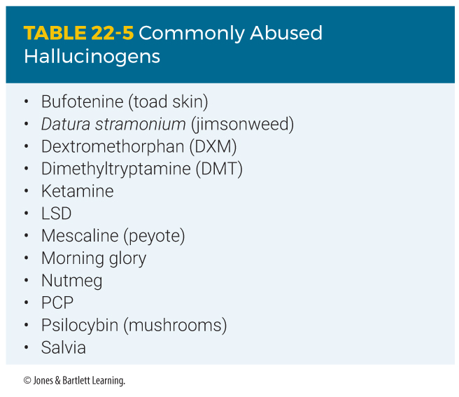
Hallucinogens (1 of 3)
Hallucinogens alter a person’s sensory perceptions.
  Classic example is LSD.
Notes:
Lecture Outline
K. Hallucinogens
1. Hallucinogens alter a person’s sensory perceptions.
a. The classic hallucinogen is lysergic acid diethylamide (LSD).

Slide 78
Hallucinogens (2 of 3)
These agents:
  Cause visual hallucinations
  Intensify vision and hearing
  Generally separate the user from reality
Patients experiencing a “bad trip” have hypertension, tachycardia, anxiety, and paranoia.
Notes:
Lecture Outline
2. These agents:
a. Cause visual hallucinations
b. Intensify vision and hearing
c. Generally separate the user from reality
3. Patients experiencing a “bad trip” have:
a. Hypertension
b. Tachycardia
c. Anxiety
d. Paranoia

Slide 79
Hallucinogens (3 of 3)
Use a calm, professional manner.
Provide emotional support.
Do not use restraints unless you or the patient is in danger of injury.
Watch the patient carefully throughout transport and do not leave unattended.
Request ALS assistance when appropriate.
Notes:
Lecture Outline
4. Care is the same as that for a patient who has taken a sympathomimetic.
a. Use a calm, professional manner.
b. Provide emotional support.
c. Do not use restraints unless you or the patient is in danger of injury.
d. Watch the patient carefully throughout transport and do not leave unattended.
e. Request ALS assistance when appropriate.

Slide 80
Anticholinergic Agents (1 of 2)
Have properties that block the parasympathetic nerve.
“Hot as a hare, blind as a bat, dry as a bone, red as a beet, and mad as a hatter.”
Common drugs include atropine, Benadryl, jimsonweed, and amitriptyline.
Notes:
Lecture Outline
L. Anticholinergic agents
1. Medications that have properties that block the parasympathetic nerve.
2. The classic picture of a person who has taken too much of an anticholinergic medication is “hot as a hare, blind as a bat, dry as a bone, red as a beet, and mad as a hatter.”
3. Common drugs include atropine, Benadryl, jimsonweed, and amitriptyline (Elavil).
4. It is often difficult to distinguish between an anticholinergic overdose and a sympathomimetic overdose. Both groups of patients may be agitated and have tachycardia and dilated pupils.

Slide 81
Anticholinergic Agents (2 of 2)
Some tricyclic antidepressants have significant anticholinergic effects.
Death from these agents can be rapid.
  The patient can go from “normal” to seizure and death within 30 minutes.
  Transport immediately.
  Consider ALS backup.
Notes:
Lecture Outline
5. Some tricyclic antidepressants have significant anticholinergic effects.
a. Death from these agents can be rapid—the patient can go from appearing “normal” to seizure and death within 30 minutes.
b. Transport immediately; consider calling for ALS backup en route.

Slide 82
Cholinergic Agents (1 of 5)
Overstimulate normal body functions that are controlled by the parasympathetic nerves.
  Include “nerve gases” designed for chemical warfare and organophosphate insecticides
Notes:
Lecture Outline
M. Cholinergic agents
1. Overstimulate normal body functions that are controlled by the parasympathetic nerves.
2. Includes “nerve gases” designed for chemical warfare and organophosphate insecticides.

Slide 83
Cholinergic Agents (2 of 5)
Use the mnemonic DUMBELS to remember the signs and symptoms:
  Diarrhea
  Urination
  Miosis
  Bradycardia, bronchospasm, bronchorrhea
  Emesis
  Lacrimation
  Seizures, salivation, sweating
Notes:
Lecture Outline
3. The signs and symptoms of cholinergic drug poisoning are easy to remember with the mnemonic DUMBELS:
a. Diarrhea
b. Urination
c. Miosis (constriction of the pupils)
d. Bradycardia, bronchospasm, bronchorrhea (discharge of mucus from the lungs)
e. Emesis (vomiting)
f. Lacrimation (tearing)
g. Seizures, salivation, sweating

Slide 84
Cholinergic Agents (3 of 5)
Or, you can use SLUDGEM:
  Salivation, sweating
  Lacrimation
  Urination
  Defecation, drooling, diarrhea
  Gastric upset and cramps
  Emesis
  Muscle twitching/miosis
Notes:
Lecture Outline
4. Alternatively, you can use the mnemonic SLUDGEM:
a. Salivation, sweating
b. Lacrimation
c. Urination
d. Defecation, drooling, diarrhea
e. Gastric upset and cramps
f. Emesis
g. Muscle twitching/miosis

Slide 85
Cholinergic Agents (4 of 5)
The most important consideration is to avoid exposure yourself.
  Decontamination may take priority over immediate transport.
  Hazmat team will provide decontamination and contain the exposure chemical.
  After decontamination:
    Decrease the secretions in the mouth and trachea.
    Provide airway support.
Notes:
Lecture Outline
5. The most important consideration is to avoid exposure yourself.
a. Decontamination may take priority over immediate transport.
i. In many jurisdictions, the hazmat team will provide decontamination and contain the exposure chemical.
b. Your priorities after decontamination are to decrease the secretions in the mouth and trachea and provide airway support.

Slide 86
Cholinergic Agents (5 of 5)
Antidote kit may be available.
  DuoDote Auto-Injector
  The kit consists of a single auto-injector containing atropine and pralidoxime.
  If a known exposure to nerve agents with manifestation of signs and symptoms has occurred, use the antidote kit on yourself.
Notes:
Lecture Outline
6. Antidote kits may be available.
a. Most common is the DuoDote Auto-injector.
b. The kit consists of a single auto-injector containing atropine and pralidoxime.
c. If a known exposure to nerve agents or organophosphates with manifestation of signs and symptoms has occurred, use the antidote kit on yourself.

Slide 87
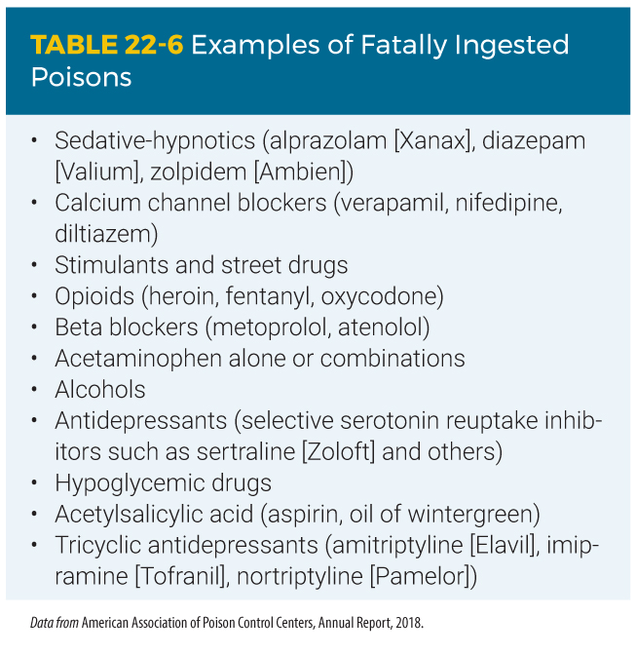
Miscellaneous Drugs (1 of 5)
Accidental or intentional overdose with cardiac medications has become common.
  Children
  Older patients
Notes:
Lecture Outline
N. Miscellaneous drugs
1. Accidental or intentional overdose with cardiac medications has become common.
a. Children may ingest them thinking they are candy.
b. Older patients may forget and take a second dose of their medication.

Slide 88
Miscellaneous Drugs (2 of 5)
Signs and symptoms depend on the medication ingested.
Contact the poison center as soon as possible.
Notes:
Lecture Outline
c. Signs and symptoms depend on the medication ingested.
d. Contact the poison center as soon as possible.

Slide 89
Miscellaneous Drugs (3 of 5)
Aspirin poisoning remains a potentially lethal condition.
Ingesting too many aspirin may result in:
  Nausea
  Vomiting
  Hyperventilation
  Ringing in the ears
Notes:
Lecture Outline
2. Aspirin poisoning remains a potentially lethal condition.
a. Ingesting too many may result in:
i. Nausea
ii. Vomiting
iii. Hyperventilation
iv. Ringing in the ears

Slide 90
Miscellaneous Drugs (4 of 5)
Patients with this problem have:
  Anxiety
  Confusion
  Tachypnea
  Hyperthermia
  Danger of having seizures
Notes:
Lecture Outline
b. Patients with this problem frequently have:
i. Anxiety
ii. Confusion
iii. Tachypnea
iv. Hyperthermia
v. Danger of having seizures

Slide 91
Miscellaneous Drugs (5 of 5)
Overdosing with acetaminophen is also very common.
Some alcohols, including methyl alcohol and ethylene glycol, are even more toxic than ethyl alcohol (drinking alcohol).
Notes:
Lecture Outline
3. Overdosing with acetaminophen and medications that contain acetaminophen is also common.
a. Accidental acetaminophen overdose is as serious as intentional overdose.
4. Some alcohols, including methyl alcohol and ethylene glycol, are even more toxic than ethyl alcohol (drinking alcohol).
a. Both will cause severe tachypnea, blindness, renal failure, and eventually death.

Slide 92
Food Poisoning (1 of 6)
Almost always caused by eating food contaminated by bacteria
Two main types:
  Organism itself may cause disease.
  Organism may produce toxins that cause disease.
Notes:
Lecture Outline
VII. Food Poisoning
A. Food poisoning is almost always caused by eating food contaminated by bacteria.
1. The organism itself may cause disease.
2. The organism may produce toxins that cause disease.

Slide 93
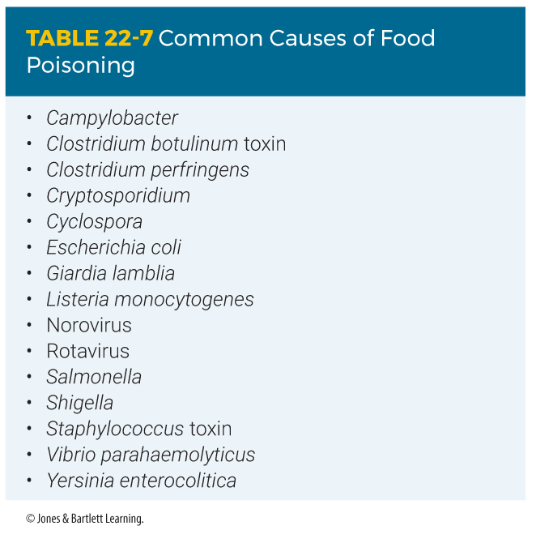
Food Poisoning (2 of 6)
One organism that produces direct effects of food poisoning is the Salmonella bacterium.
Notes:
Lecture Outline
B. One organism that produces direct effects of food poisoning is the Salmonella bacterium.

Slide 94
Food Poisoning (3 of 6)
Causes salmonellosis
  Characterized by severe GI symptoms within 72 hours of ingestion, including nausea, vomiting, abdominal pain, and diarrhea
  Proper cooking kills bacteria, and proper cleanliness in the kitchen prevents the contamination of uncooked foods.
Notes:
Lecture Outline
1. Salmonellosis is characterized by severe gastrointestinal symptoms within 72 hours of ingestion, including nausea, vomiting, abdominal pain, and diarrhea.
2. Proper cooking kills bacteria, and proper cleanliness in the kitchen prevents the contamination of uncooked foods.

Slide 95
Food Poisoning (4 of 6)
The more common cause of food poisoning is the ingestion of powerful toxins produced by bacteria, often in leftovers.
  The bacterium Staphylococcus is quick to grow and produce toxins in food.
  Foods left unrefrigerated are a common vehicle.
  Symptoms usually within start 2 to 3 hours or as long as 8 to 12 hours after ingestion.
Notes:
Lecture Outline
C. The more common cause of food poisoning is the ingestion of powerful toxins produced by bacteria, often in leftovers.
1. The bacterium Staphylococcus is quick to grow and produce toxins in food.
2. Foods left unrefrigerated are a common vehicle.
3. Results in sudden GI symptoms, including nausea, vomiting, and diarrhea
4. Symptoms usually start within 2 to 3 hours after ingestion or as long as 8 to 12 hours after ingestion.

Slide 96
Food Poisoning (5 of 6)
The most severe form of toxin ingestion is botulism.
  Can result from eating improperly canned food
  Symptoms are neurologic:
    Blurring of vision
    Weakness
    Difficulty in speaking and breathing
Notes:
Lecture Outline
D. The most severe form of toxin ingestion is botulism.
1. Botulism can result from eating improperly canned food.
a. The spores of Clostridium bacteria grow and produce a toxin.
2. The symptoms are neurologic.
a. Blurring of vision
b. Weakness
c. Difficulty in speaking and breathing
3. Often fatal, symptoms may develop within the first 24 hours after ingestion or as long as 4 days later.

Slide 97
Food Poisoning (6 of 6)
Do not try to determine the specific cause of acute GI problems.
  Gather as much history as possible from the patient.
  When two or more persons have the same illness, take along the suspected food.
Notes:
Lecture Outline
E. In general, do not try to determine the specific cause of acute gastrointestinal problems.
1. Gather as much history as possible from the patient and transport him or her promptly to the hospital.
2. When two or more persons in one group have the same illness, you should take along some of the suspected food.

Slide 98
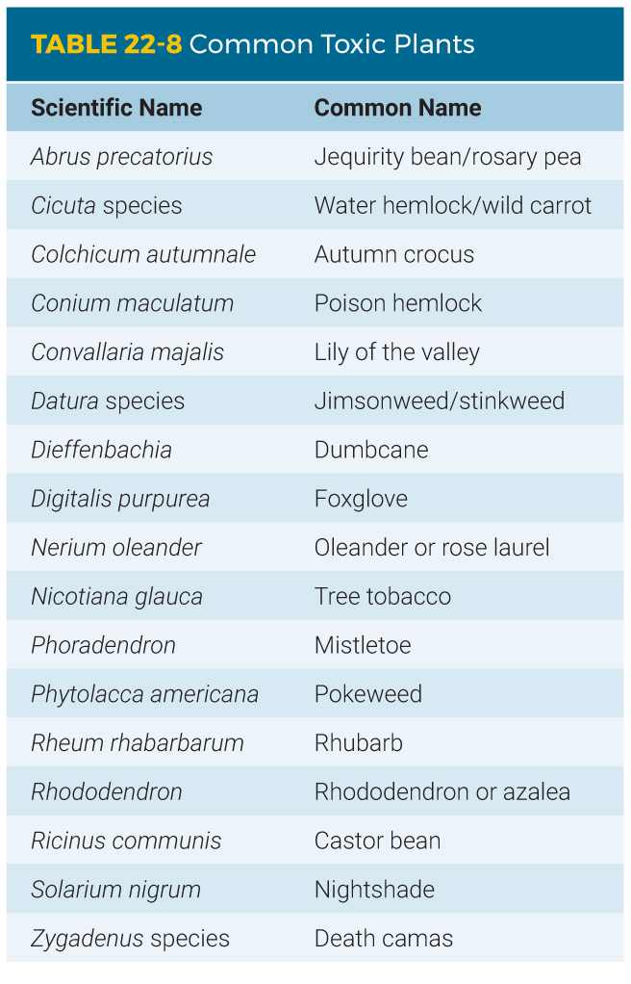
Plant Poisoning (1 of 4)
There are tens of thousands of cases of plant poisoning annually.
  Many household plants are poisonous if ingested.
Notes:
Lecture Outline
VIII. Plant Poisoning
A. There are tens of thousands of cases of plant poisoning annually.
1. Many household plants are poisonous if ingested.
2. Some cause local skin irritation.
3. Some can affect the circulatory system, the gastrointestinal tract, or the CNS.

Slide 99
Plant Poisoning (2 of 4)
It is impossible to memorize every plant or poison, let alone their effects.
  Assess the patient’s airway and vital signs.
  Notify the regional poison center.
  Take the plant to the emergency department.
Notes:
Lecture Outline
B. It is impossible to memorize every plant and poison, let alone their effects.
1. Assess the patient’s airway and vital signs.
2. Notify the regional poison center for assistance in identifying the plant.
3. Take the plant to the emergency department.

Slide 100
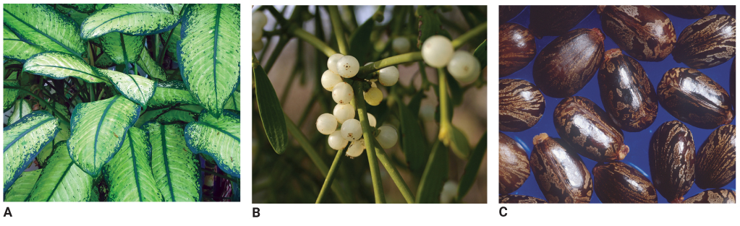
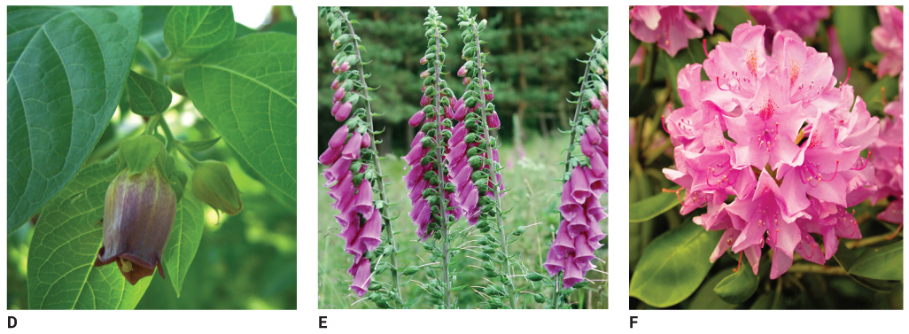
Plant Poisoning (3 of 4)
A: © Andriy Doriy/Shutterstock; B: © Robert Johnson/Shutterstock;
C: Courtesy of Brian Prechtel/USDA. D: © H. Brauer/Shutterstock;
E: © Jean Ann Fitzhugh/Shutterstock; F: © Kateryna hyzhnyak/Dreamstime.com
FIGURE 22-10 The toxins in these common poisonous plants are often ingested or absorbed through the skin. A. Dieffenbachia. B. Mistletoe. C. Castor bean.
D. Nightshade. E. Foxglove. F. Rhododendron
Notes:
The figures on this slide show common poisonous plants: Dieffenbachia (A), Mistletoe (B), Castor Bean (C), Nightshade (D), Foxglove (E), Rhododendron (F)

Slide 101

Plant Poisoning (4 of 4)
G: © Travis Klein/Shutterstock; H: Courtesy of Walter Siegmund;
I: © LianeM/Shutterstock; J: © Forest & Kim Starr [http://www.hear.org/starr/plants/]. Used with permission; K: © Thomas Photography LLC/Alamy; L: © Thomas J. Peterson/Alamy; M: Courtesy of U.S. Fish & Wildlife Service.
G. Jimsonweed. H. Death camas. I. Poison ivy. J. Poison oak.
K. Pokeweed. L. Rosary pea. M. Poison sumac.
Notes:
The figures on this slide show common poisonous plants: Jimsonweed (G), Death camas (H), Poison ivy (I), Poison oak (J), Pokeweed (K), Rosary pea (L), Poison sumac (M)

Slide 102
Review
Which of the following questions is of LEAST pertinence for the EMT to ask a patient who intentionally overdosed on a medication?
  “How much do you weigh?”
  “How much did you ingest?”
  “What substance did you take?”
  “Why did you take the medication?”

Slide 103
Review
Answer: D
Rationale: Determining what the patient ingested, how much was ingested, and the patient’s weight are all pertinent and have a direct impact on the care that is provided during the acute phase. Why the patient ingested the medication does not have a direct impact on acute care; therefore, it is the least pertinent question to ask.

Slide 104
Review
Which of the following questions is of LEAST pertinence for the EMT to ask a patient who intentionally overdosed on a medication?
  “How much do you weigh?”
  Rationale: This is a very pertinent question and can impact treatment.
  “How much did you ingest?”
  Rationale: This is a very pertinent question and can impact treatment.
  “What substance did you take?”
  Rationale: This is a very pertinent question and can impact treatment.
  “Why did you take the medication?”
  Rationale: Correct answer

Slide 105
Review
A 30-year-old male who ingested an unknown substance begins to vomit. You should:
  collect the vomitus and bring it to the hospital.
  apply a bag-mask device.
  analyze the vomitus and try to identify the poison.
  suction his oropharynx for no longer than 30 seconds.

Slide 106
Review
Answer: A
Rationale: If the patient vomits, examine the contents for pill fragments. Ensure that you are wearing proper personal protective equipment for this activity. Note and document anything unusual that you see. You should try to collect the vomitus in a separate plastic bag so that it can be analyzed at the hospital.

Slide 107
Review
A 30-year-old male who ingested an unknown substance begins to vomit.
You should:
  collect the vomitus and bring it to the hospital.
  Rationale: Correct answer
  apply a bag-mask device.
  Rationale: This will not help get rid of the vomitus.
  analyze the vomitus and try to identify the poison.
  Rationale: This should be left for the hospital to do.
  suction his oropharynx for no longer than
  30 seconds.
  Rationale: You should suction for no longer than 15 seconds.

Slide 108
Review
When caring for a patient with a surface contact poisoning, it is important to remember to:
  prevent contamination of the patient.
  avoid contaminating yourself or others.
  let the hospital remove the surface poison.
  immediately flush dry chemicals with water.

Slide 109
Review
Answer: B
Response: Emergency care for a patient with a surface contact poisoning includes avoiding contaminating yourself and others and removing the irritating or corrosive substance from the patient as rapidly as possible. Dry chemicals must be brushed from the body prior to flushing with water.

Slide 110
Review
When caring for a patient with a contact poisoning, it is important to remember to:
  prevent contamination of the patient.
  Rationale: The patient is already contaminated, and you must try to minimize further contamination.
  avoid contaminating yourself or others.
  Rationale: Correct answer
  let the hospital remove the surface poison.
  Rationale: Remove irritating or corrosive substances as rapidly as possible.
  immediately flush dry chemicals with water.
  Rationale: You must brush off dry chemicals first before washing.

Slide 111
Review
Most poisonings occur via the _________ route.
  injection
  ingestion
  inhalation
  absorption

Slide 112
Review
Answer: B
Rationale: Approximately 80% of all poisonings occur by ingestion.

Slide 113
Review
Most poisonings occur via the _________ route.
  injection
  Rationale: Less than 20% of poisonings occur via injection.
  ingestion
  Rationale: Correct answer
  inhalation
  Rationale: Less than 20% of poisonings occur via inhalation.
  absorption
  Rationale: Less than 20% of poisonings occur via absorption.

Slide 114
Review
How much activated charcoal should you administer to a 55-pound child who swallowed a bottle of aspirin?
  12.5 g
  25 g
  2 g/kg
  50 g

Slide 115
Review
Answer: B
Rationale: The usual dose of activated charcoal for adults and children is 1 g of charcoal per kg of body weight. To convert a patient’s weight from pounds to kilograms, simply divide the weight in pounds by 2.2. Therefore, a 55-pound child should receive 25 g of activated charcoal (55 [pounds] ÷ 2.2 = 25 [kg]). The average pediatric dosing range for activated charcoal is 12.5 to 25 g.

Slide 116
Review
How much activated charcoal should you administer to a 55-pound child who swallowed a bottle of aspirin?
  12.5 g
  Rationale: 12.5 g at 1 g/kg dose would be given to a 27-lb child.
  25 g
  Rationale: Correct answer
  2 g/kg
  Rationale: The standard dose is 1 g/kg.
  50 g
  Rationale: 50 g at 1 g/kg dose would be given to a patient weighing 110 lbs.

Slide 117
Review
After taking Vicodin for 2 years for chronic pain, a 40-year-old woman finds that her usual dosage is no longer effective and goes to the doctor to request a higher dosage. This is an example of:
  addiction.
  dependence.
  tolerance.
  drug abuse.

Slide 118
Review
Answer: C
Rationale: A person who takes a medication for a prolonged period of time often finds that higher doses of the medication are required to achieve the same effect. This is called tolerance.

Slide 119
Review
After taking Vicodin for 2 years for chronic pain, a 40-year-old woman finds that her usual dosage is no longer effective and goes to the doctor to request a higher dosage. This is an example of:
  addiction.
  Rationale: This is a physiologic or psychological dependence on a potentially harmful drug.
  dependence.
  Rationale: This is a physiologic or psychological need to use a drug.
  tolerance.
  Rationale: Correct answer
  drug abuse.
  Rationale: This is the deliberate use of an illegal drug or too much of a prescribed drug.

Slide 120
Review
Which of the following effects does drinking alcohol NOT produce?
  Induction of sleep
  Slowing of reflexes
  Inappropriate behavior
  Increased sense of awareness

Slide 121
Review
Answer: D
Rationale: Drinking alcohol (ethyl alcohol) is both a sedative (decreases activity and excitement) and a hypnotic (induces sleep). It dulls the sense of awareness, slows reflexes, and reduces reaction time. It may also cause aggressive or inappropriate behavior and lack of coordination.

Slide 122
Review
Which of the following effects does drinking alcohol NOT produce?
  Induction of sleep
  Rationale: It is a hypnotic and induces sleep.
  Slowing of reflexes
  Rationale: It is a sedative and reduces reaction time.
  Inappropriate behavior
  Rationale: It may cause aggressive or inappropriate behavior.
  Increased sense of awareness
  Rationale: Correct answer

Slide 123
Review
A 21-year-old male was found unconscious in an alley. Your initial assessment reveals that his respirations are slow and shallow, and his pulse is slow and weak. Further assessment reveals that his pupils are bilaterally constricted. His presentation is MOST consistent with an overdose of:
  cocaine.
  an opioid.
  a stimulant drug.
  methamphetamine.

Slide 124
Review
Answer: B
Rationale: Opioids are central nervous system depressant drugs; when taken in excess, they cause respiratory depression, bradycardia, and hypotension. Another common sign is miosis (constricted [pinpoint]) pupils. Cocaine, stimulant drugs (uppers), and methamphetamine have the opposite effect; they stimulate the central nervous system and cause tachycardia and hypertension.

Slide 125
Review
A 21-year-old male was found unconscious in an alley. Your initial assessment reveals that his respirations are slow and shallow, and his pulse is slow and weak. Further assessment reveals that his pupils are bilaterally constricted. His presentation is MOST consistent with an overdose of:
  cocaine.
  Rationale: This increases the vitals, heart rate, pulse, and breathing.
  an opioid.
  Rationale: Correct answer
  a stimulant drug.
  Rationale: This increases the vitals, heart rate, pulse, and breathing.
  methamphetamine.
  Rationale: This increases the vitals, heart rate, pulse, and breathing.

Slide 126
Review
The mnemonic DUMBELS can be used to recall the signs and symptoms of a cholinergic drug poisoning. The “E” in DUMBELS stands for:
  emesis.
  erythema.
  ecchymosis.
  elevated blood pressure.

Slide 127
Review
Answer: A
Rationale: The mnemonic “DUMBELS,” which can help you recall the signs and symptoms of cholinergic drug poisoning
(ie, organophosphates), stands for excessive defecation, urination, miosis (pupillary constriction), bronchorrhea, emesis, lacrimation, and salivation.

Slide 128
Review
The mnemonic DUMBELS can be used to recall the signs and symptoms of a cholinergic drug poisoning. The “E” in DUMBELS stands for:
  emesis.
  Rationale: Correct answer
  erythema.
  Rationale: Erythema is a redness of the skin usually caused by fever or inflammation.
  ecchymosis.
  Rationale: Ecchymosis is bleeding from broken blood vessels into surrounding tissue.
  elevated blood pressure.
  Rationale: Elevated blood pressure usually causes bradycardia.

Slide 129
Review
Food poisoning is almost always caused by eating food that contains:
  fungi.
  viruses.
  bacteria.
  protozoa.

Slide 130
Review
Answer: C
Rationale: Food poisoning is almost always caused by eating food that contains bacteria. Salmonella poisoning and botulism—two common forms of food poisoning—are both caused by bacteria.

Slide 131
Review
Food poisoning is almost always caused by eating food that contains:
  fungi.
  Rationale: Fungi include mildews, molds, mushrooms, rusts, smuts, and yeasts.
  viruses.
  Rationale: Viruses are not considered to be independent living organisms. Viruses need a living host and are not found in food.
  bacteria.
  Rationale: Correct answer
  protozoa.
  Rationale: Protozoa are single-celled organisms.

